Slide 1
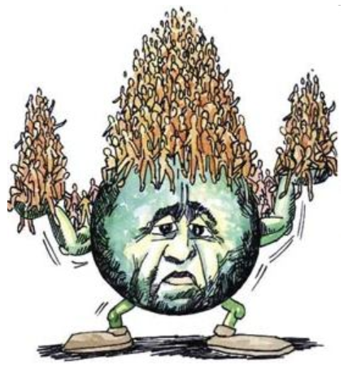
Targeting the causes of biodiversity loss:
Overpopulation

Slide 2
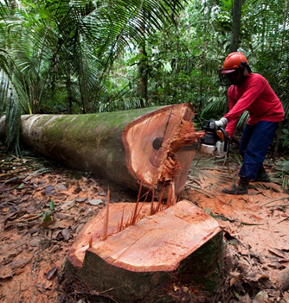


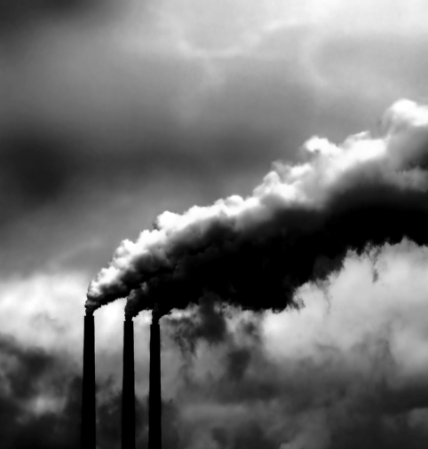
Targeting the causes of biodiversity loss: Overpopulation control
Education
Corruption
Inequity
Wealth
What about from here up?
To many humans
Human needs
Household
Food
Energy
Protected areas, Regulation policies
Deforestation
Habitat modification
Over-harvesting
CO2 emissions

Slide 3
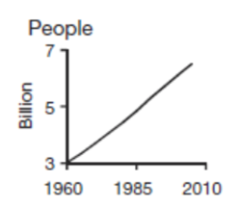
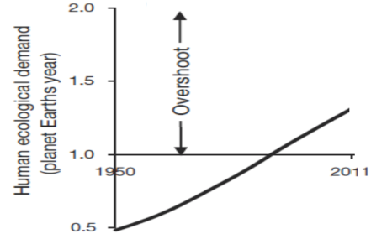
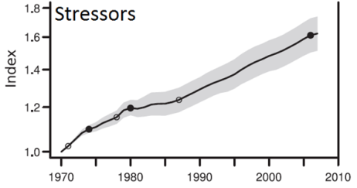
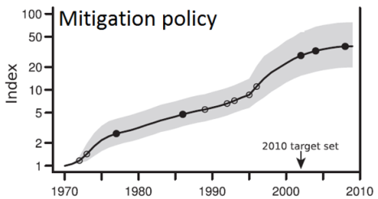
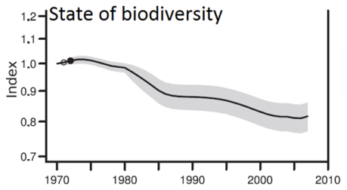
How strong is the linkage between overpopulation and proximal stressors and biodiversity loss?
Human population
Ultimate driver
Household
Food
Energy
Habitat loss
Overexploitation
Climate change: Warming, Acidification
Pollution: sewage, erosion, eutrophication
Invasive species
Proximal
driver
Protected areas
Quota limits
CO₂ caps
Alternative energies
Education awareness
Treatment plants
Manual controls
Traffic reduction
Not working
Biodiversity status
Butchard et al (Science 2010)
Mora & Sale (2011)

Slide 4
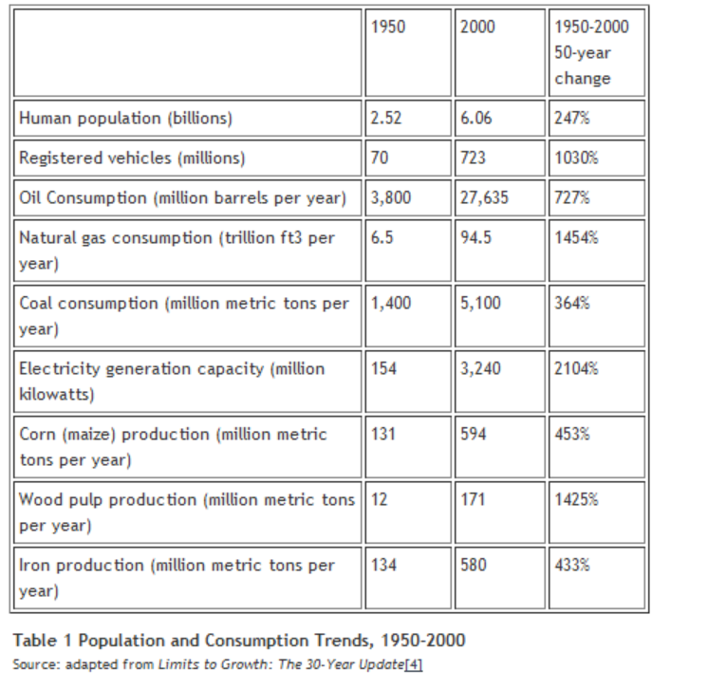
How strong is the linkage between overpopulation and proximal stressors and biodiversity loss?
Clearly, the more people the more consumption of everything

Slide 5
The problem is also very concerning ‘cause:
Ongoing loss of biodiversity
Expanding desertification
Changing climate
Over 20.000 extinct
species a year
Over 10.000 million
hectares loss a year
~ 1ºC increase since the
industrial revolution
We have reached our carrying capacity
88% of non-renewable natural resource are scarce
One billion people
go hungry every year
One billion people
lack access to water
Decline in resources
Hunger
Water shortfall

Slide 6
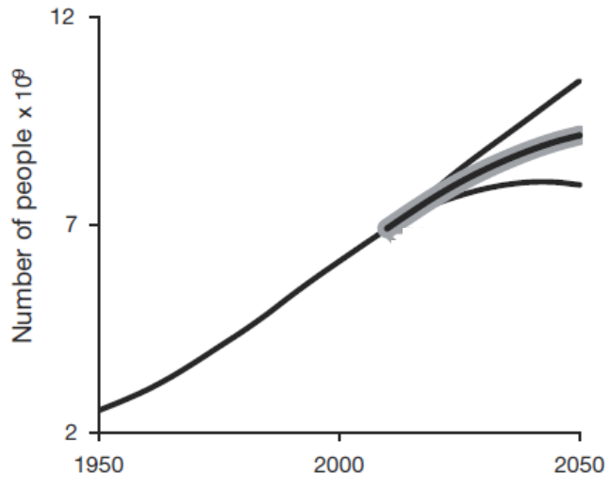
The solution is simple
Lets have fewerchildren
So what is the deal?
Empowering women
Sex education
Cheap contraceptives
The problem is still on

Slide 7
How to solve a problem?
55
Each year:
~100⁶ people
~20³ species loss
~10⁶ hectares loss
~400⁹ CO2 tonnes
Global funding on family planning
5
Scientists study
Politicians act
Bottleneck
A problem
Public responds
Problem solved
Overpopulation
68
US public opinion on overpopulation as an issue
Human population
(Billions)
8
0

Slide 8
The bottleneck is clearly in the interface scientists-public
Scientists
► limited rewards and discouragement by institutions
► limited skills and avenues for communication
► the loss of personal time
► possible lack of support or approval from colleagues
► possible attacks by interest groups
► the possibility that such efforts may fail
► the potential loss of one’s job
Few scientists are willing to take a stand
Seminal reports on:
Climate change (IPCC)
Food security (Foley et al Nature 2011)
Biodiversity loss (Biodiversity Outlook 2011)
Human health (Yamey PlosBiology 2007)
no mention of overpopulation
Public

Slide 9
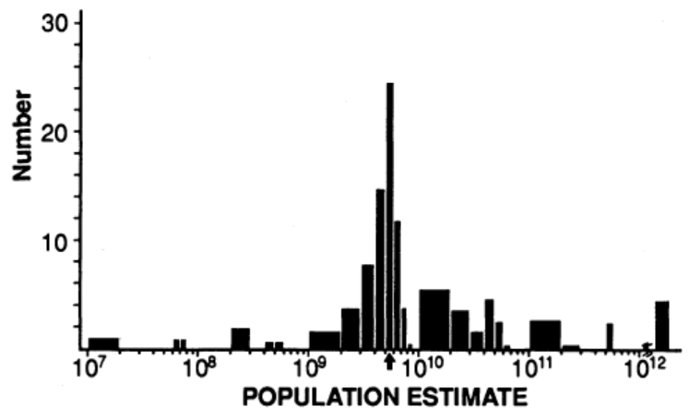
The bottleneck is clearly in the interface scientists-public
Scientists
Scientific illiteracy of the public in general
Below 17% in most countries
Failure to appreciate:
► the link between individual actions and environmental conditions
► how human activities aggregate to affect the health of the biosphere
► real comprehension of what overpopulation numbers mean
How many people do you think are there in the world?
96 Billion
3 trillion
10 million
Meffe, Conservation Biology 1994
► Abstractness of the problem
► Failure to differentiate the meaning of million, billion, and trillion
Public

Slide 10
The bottleneck is clearly in the interface scientists-public
Scientists
Knowledge
so good
► scientific literacy is also a “...a conceptual tool kit…to…ask questions, identify assumptions, and make well-reasoned decisions”
RELIGION
Religion | Population
Christianity | 2.2 billion
Buddhism | 1.9 billion
Islam | 1.6 billion
Hinduism | 1 billion
Override peoples’ beliefs
Oppose contraception or
Promote “procreate and abound in number.”
Public

Slide 11
The bottleneck is clearly in the interface scientists-public
Scientists
► Scientific disinterest on the issue
+
Bottleneck
► Scientific illiteracy
► Religion
► skepticism from historical “flip-flops” about of overpopulation
► environmental generational amnesia
► declining interest on environmental issues over other more pressing issues
► overload of information and avoidance of information perceived as irrelevant
► psychological biases toward short term versus long-term gains
► attention cycle driven by the sound-bite style of news and politicians careers
Public

Slide 12
However, we do have an edge to break loose from that bottleneck
Climate change
Kyoto Protocol
→ binding targets for reducing greenhouse gas
? Solution ?
Solution
greenhouse gas emissions = consumption x population
Solution
► carbon legacy increase by 40 times for each newborn (1)
► funding family planning to prevent unwanted pregnancies will yield a CO2 reduction equivalent to that from implementing exiting technologies but at a cost 5 times more cheaper (2)
► future externalities of CO2 mitigation could be in the order of 1,000 to 20,000 per person (3)
Technology
Averting additional natality could cost only $220 per birth through family planning and $175 through sex education (4)
Definitive solutions will require not only smaller footprints
, but fewer feet
References:
Murtaugh & Schlax , Global Environmental Change (2009)
Wire , Report (2009)
O'Neill & Wexler, Climatic Change (2000)
Birdsall, Book (1992)

Slide 13
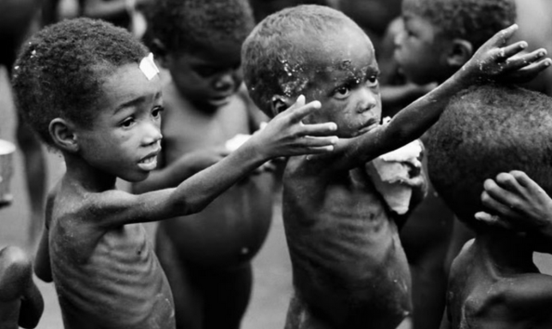

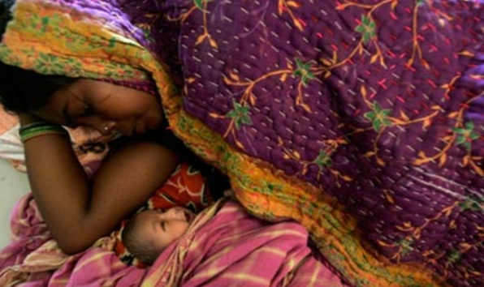
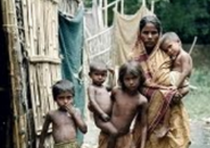

Currently, we do have an edge to break loose from that bottleneck
Welfare
Millennium Development Goals
→ To improve the welfare of the world’s poorest people
Specific goals
Poverty and hunger
Education
Woman mortality at labor
Unattainable
Unattainable
Unattainable
Child mortality
Infections diseases
Unattainable
Unattainable
If we are to improve welfare we need to deal with overpopulation

Slide 14
Currently, we do have an edge to break loose from that bottleneck
Employment
2011 Pew opinion pool on what is most concerning to you?
Jobs
National debt
No environmental concern
No Overpopulation
560 million people aged 55 to 64
Age
1.2 billion – 560 million = 640 million jobs worldwide
1.2 billion aged 5 to 14
People

Slide 15
Currently, we do have an edge to break loose from that bottleneck
Debt
What is most concerning to you?
Jobs
National debt
No environmental concern
No Overpopulation
Social services spending: 16% share in 1966 to a 40% share in 2006
Age
US$40 trillion deficit over the next 75 years
People

Slide 16
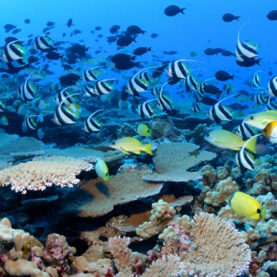
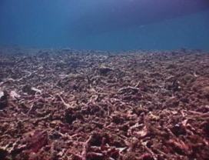
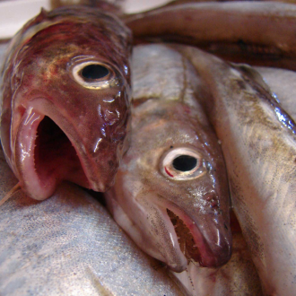
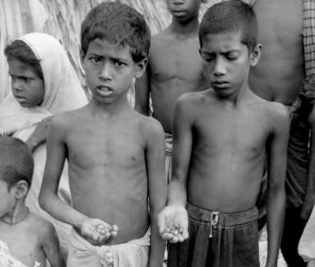
End of second class section
…summary…
Biodiversity loss can deter many different goods and services
Biodiversity is a unique and striking feature of Earth
Biodiversity is in a declining trend
Human well-being is at stake
Overexploitation
Climate change
Habitat loss
Human population Overconsumption
Proposed solutions all have several and serious shortfalls

